Slide 1



Demand Trends for Renewable Energy Products in Nigeria
Group 1

Slide 2

Content
01
Objective
02
Project Tasks
03
Most In-Demand Products
04
Geographic Hotspot
05
Seasonal Demand Variations
06
Recommendations
07
The Analytical Team

Slide 3


Objective
This project helps Renergy Hub understand the market demand for renewable energy products in Nigeria over time, to guide strategic decision-making for marketing and distribution priorities

Slide 4



Project Tasks
1
Identify the top three most in-demand products
2
Analyze seasonal demand variations
3
Pinpoint geographic hotspots for renewable energy demand

Slide 5
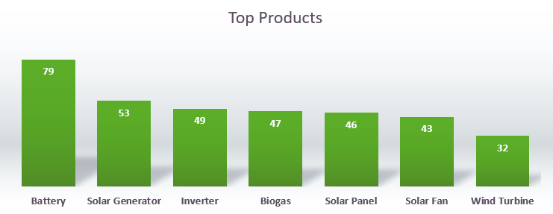

Most In-demand Products
After analysing various search terms, the top three most in-demand renewable energy products are:
Battery
Solar Generator
Inverter

Slide 6



Geographic Hotspots
Demand for renewable energy products is concentrated in specific regions. The top states showing interest include:
01
02
03
04
05
Borno
Oyo
Ogun
Ondo
Kano
Additionally, the South-West geopolitical zone emerges as a key area of interest, suggesting that this region may benefit most from targeted marketing strategies.

Slide 7
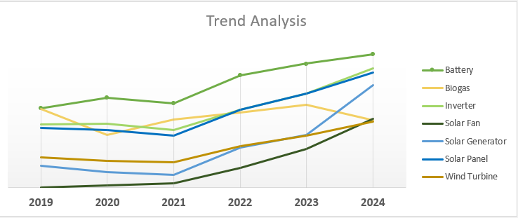

Seasonal Demand Variation
Interest in solar generators and solar fans has seen a significant uptrend since 2021
In contrast, interest in biogas products experienced a steep decline in 2024.

Slide 8

Recommendations
Focus promotional efforts on the South-West zone, especially in Borno, Oyo, Ogun and Ondo states.
Emphasize marketing around peak periods of interest to capitalise on seasonal demand variations.
Given the declining interest in biogas, Renergy Hub may benefit from concentrating resources on the growth of solar-based products, which are gaining traction.

Slide 9




The Analytical Team
Damilare Adefowope
Blessedsarah Omolola
Diseph Gum-Igonu

Slide 10


THANK YOU!

